Slide 1
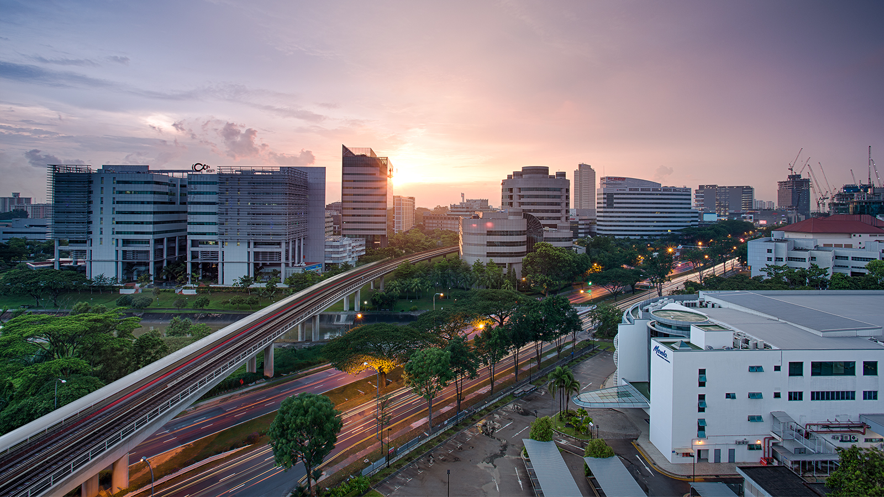
EI Project Demonstration: Public Transport System
Group 3
Eugene Choy Wen Jia Ho Min Kit Winston Ho Wei Hong Sim Li Jin Yin Yukun Yong Fu Xiang
Image retrieved from www.travelweekly-asia.com

Slide 2
Scenario
Public Transport network serves hundred of thousands of passengers everyday. Any disruption in the service would require mitigation actions to be taken to ensure minimal disruptions to the passengers.
A well-integrated public transport network across multiple systems with the various stakeholders will help enhance the communication and automate processes when mitigation actions are required

Slide 3
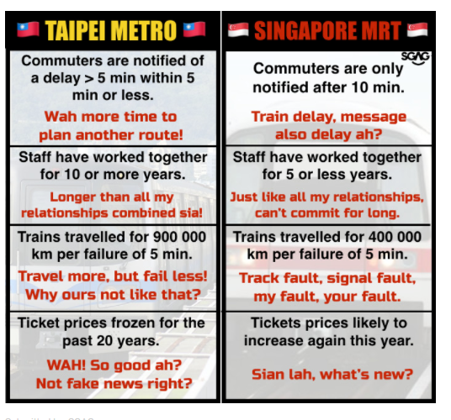
What motivates us?
"BRINGING YOU LATEST TRANSPORT UPDATE. EVEN FASTER THAN SMRT CORPORATION THROUGH INTEGRATION"

Slide 4
3 Key Processes
Train Breakdown and Resumption of Service
Weather Reporting
Schedule Polling

Slide 5

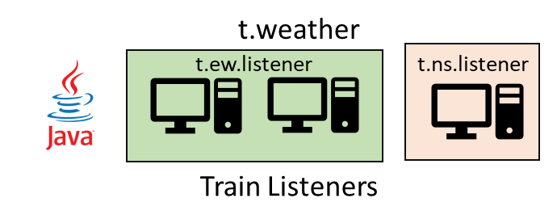
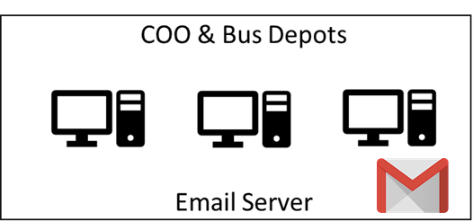

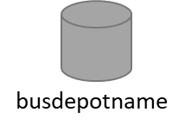
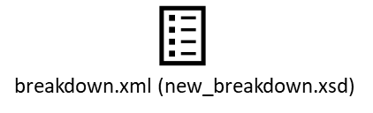



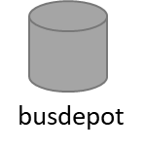
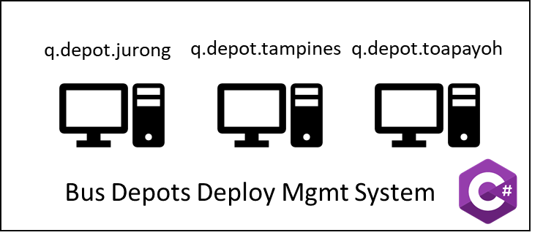


Break down messages
Heavy Rainfall Report
t.weather
t.<dynamic>.listener
Send Emails
jdbc
TIBCO BW
EMS
q.breakdown
q.deployed
q.depot.<dynamic>
t.weather
t.<dynamic>.listener
P q.breakdown (Q)
P q.deployed
C q.deployed (Q)
File Poller
busRequest.xml (new_busRequest.xsd)
Bus Management System
C q.depot.<dynamic>
HTTP
Breakdown_formatted.xml
(new_breakdown_formatted.xsd)
HTTP
HTTP

Slide 6
Train Breakdown and Resumption of Service Process

Slide 7
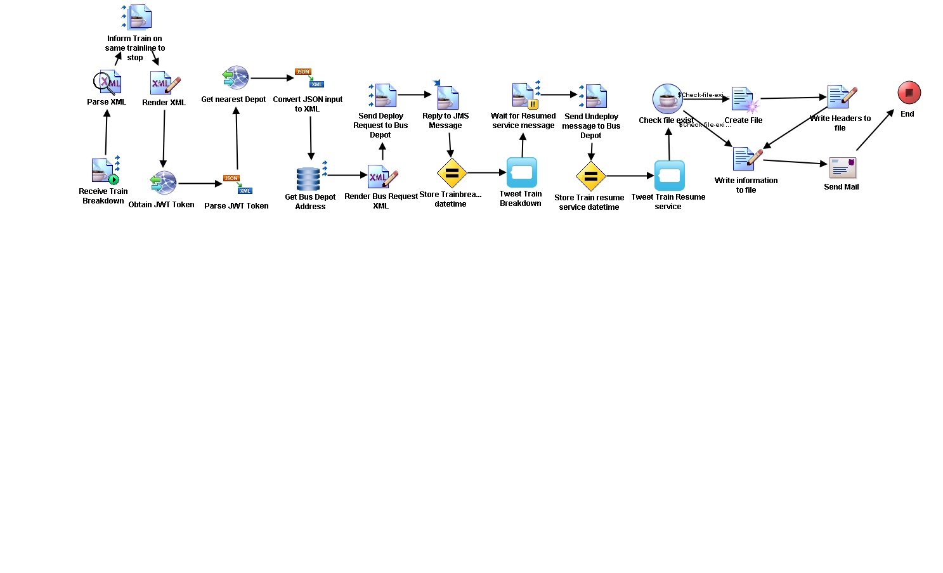
Train Breakdown
Resumption of Service

Slide 8
Break down messages
Heavy Rainfall Report
t.weather
t.<dynamic>.listener
Send Emails
jdbc
TIBCO BW
EMS
q.breakdown
q.deployed
q.depot.<dynamic>
t.weather
t.<dynamic>.listener
P q.breakdown (Q)
P q.deployed
C q.deployed (Q)
File Poller
busRequest.xml (new_busRequest.xsd)
Bus Management System
C q.depot.<dynamic>
HTTP
Breakdown_formatted.xml
(new_breakdown_formatted.xsd)
HTTP
HTTP

Slide 9

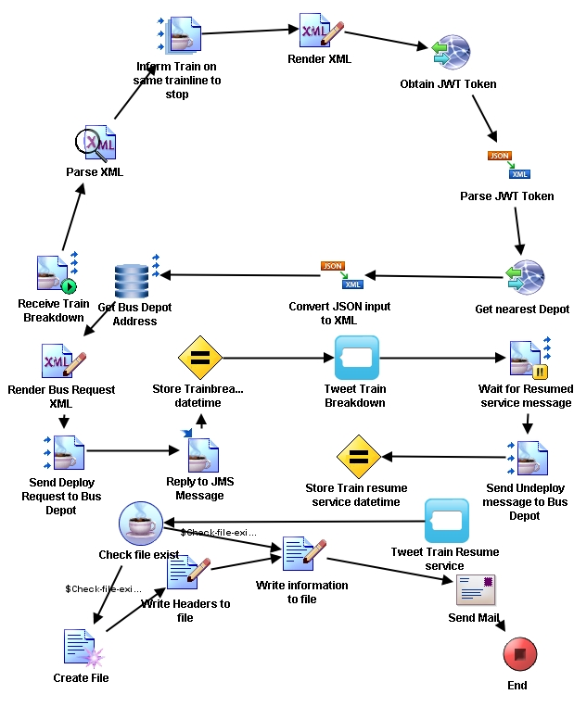

Slide 10
Weather Reporting Process

Slide 11
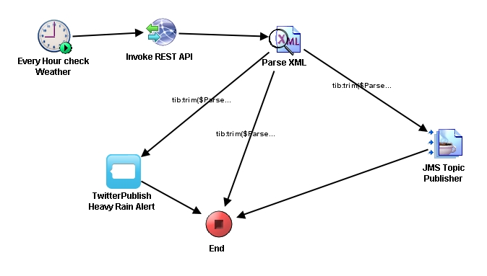

Slide 12
Break down messages
Heavy Rainfall Report
t.weather
t.<dynamic>.listener
Send Emails
jdbc
TIBCO BW
EMS
q.breakdown
q.deployed
q.depot.<dynamic>
t.weather
t.<dynamic>.listener
P q.breakdown (Q)
P q.deployed
C q.deployed (Q)
File Poller
busRequest.xml (new_busRequest.xsd)
Bus Management System
C q.depot.<dynamic>
HTTP
Breakdown_formatted.xml
(new_breakdown_formatted.xsd)
HTTP
HTTP

Slide 13
Schedule Polling Process

Slide 14
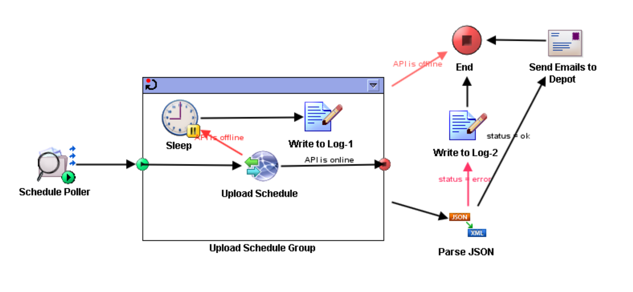

Slide 15

Break down messages
Heavy Rainfall Report
t.weather
t.<dynamic>.listener
Send Emails
jdbc
TIBCO BW
EMS
q.breakdown
q.deployed
q.depot.<dynamic>
t.weather
t.<dynamic>.listener
P q.breakdown (Q)
P q.deployed
C q.deployed (Q)
File Poller
busRequest.xml (new_busRequest.xsd)
C q.depot.<dynamic>
HTTP
Breakdown_formatted.xml
(new_breakdown_formatted.xsd)
HTTP
HTTP

Slide 16
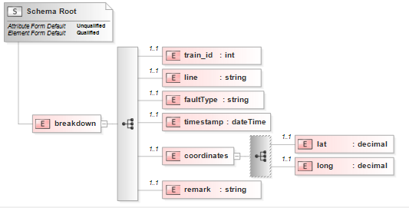
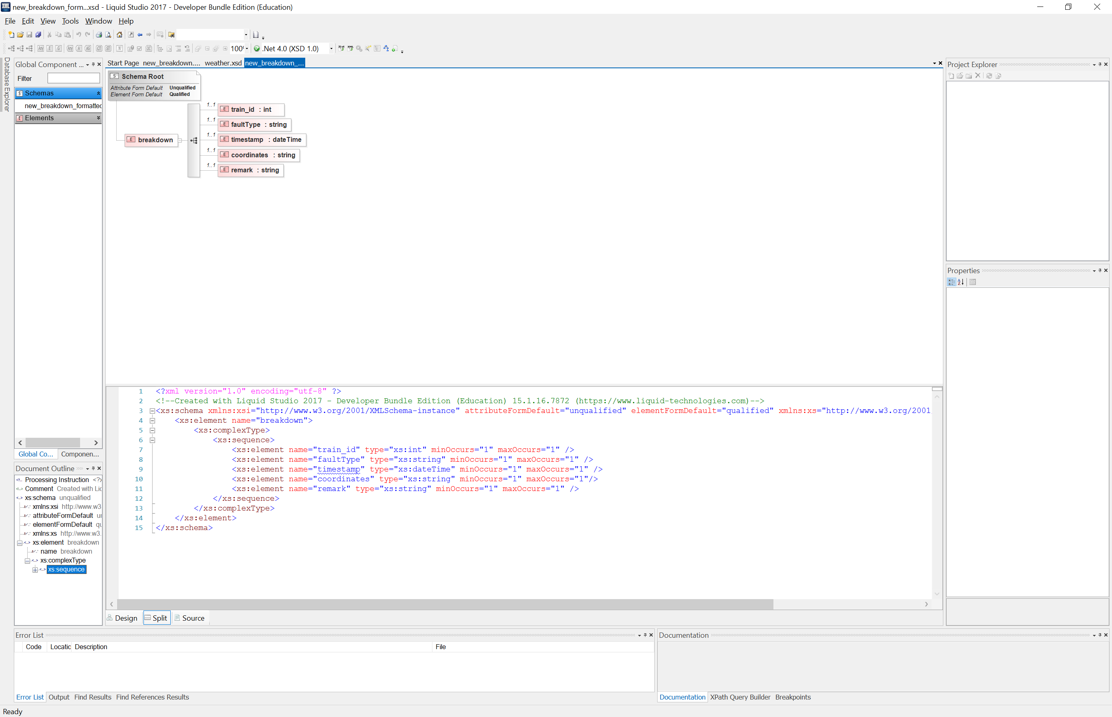
XML
<?xml version = "1.0" encoding = "UTF-8"?>
<breakdown xmlns:xsi = "http://www.w3.org/2001/XMLSchema-instance" xsi:noNamespaceSchemaLocation = "..\\new_breakdown.xsd">
<train_id>3</train_id>
<line>ew</line>
<faultType>Train Fault</faultType>
<timestamp>2018-02-20T09:00:00</timestamp>
<coordinates>
<lat>1.3272383</lat>
<long>103.9443528</long>
</coordinates>
<remark>Tanah Merah Station</remark>
</breakdown>
new_breakdown.xsd
<?xml version="1.0" encoding="UTF-8"?>
<breakdown>
<train_id>3</train_id>
<faultType>Train Fault</faultType>
<timestamp>2018-02-20T09:00:00</timestamp>
<coordinates>1.3272383,103.9443528</coordinates>
<remark>Tanah Merah Station</remark>
</breakdown>
new_breakdown_formatted.xsd

Slide 17
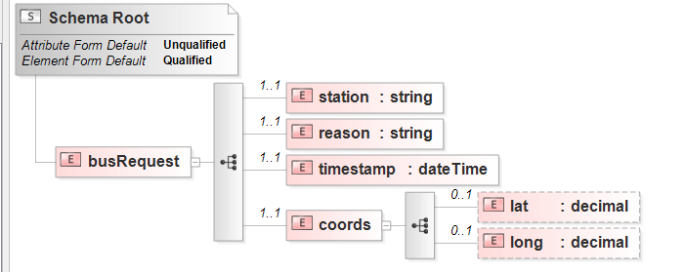
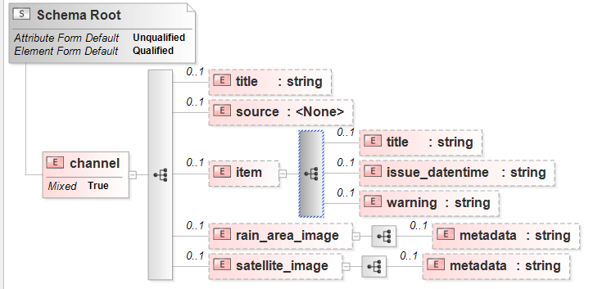
XML
<?xml version="1.0" encoding="UTF-8"?>
<busRequest>
<station>Tanah Merah Station</station>
<reason>Train Fault</reason>
<timestamp>2018-02-20T09:00:00</timestamp>
<coords>
<lat>1.3272383</lat>
<long>103.9443528</long>
</coords>
</busRequest>
busRequest.xsd
<channel>
<title>Heavy Rain Warning</title>
<source>Meteorological Service Singapore </source>
<item>
<title>HEAVY RAIN WARNING</title>
<issue_datentime>-</issue_datentime>
<warning> TRUE</warning>
</item>
<rain_area_image><metadata>null</metadata></rain_area_image>
<satellite_image><metadata>null</metadata></satellite_image>
</channel>
weather.xsd

Slide 18
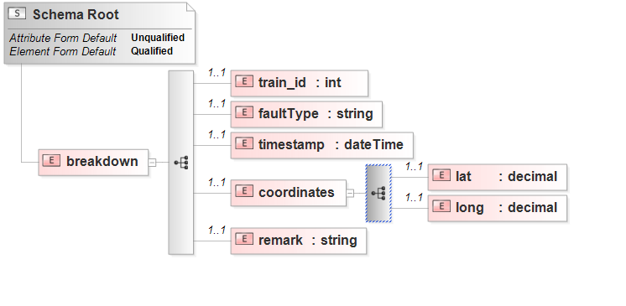
Data Transformation
concat()
new_breakdown.xsd
new_breakdown_formatted.xsd

Slide 19
Content Routing
Decide which Depot is the nearest to incident
Get Queue address of the selected depot and route it to the
correct depot

Slide 20
Beyond the Labs
3 hosted environments
(Microsoft Azure, Heroku, localhost)
4 programming languages
(C#, Java, PHP, Python)
7 out-of-classroom TIBCO BW palette
(Waiting for JMS message, Assigning variable on IM, Twitter Plugin, Send Mail Plugin, Timer Plugin, File Poller Plugin, Grouping Repeat-On-Error-Till-True)

